Slide 1

SENSORS
Interfacing to the Real World:
Review of Electrical Sensors and Actuators
Dr. Md. Sazzadur Rahman
Associate Professor
Jahangirnagar University

Slide 2


Transducers
Transducer
  a device that converts a primary form of energy into a corresponding signal with a different energy form
    Primary Energy Forms: mechanical, thermal, electromagnetic, optical, chemical, etc.
  take form of a sensor or an actuator
Sensor (e.g., thermometer)
  a device that detects/measures a signal or stimulus
  acquires information from the “real world”
Actuator (e.g., heater)
  a device that generates a signal or stimulus
real
world
sensor
intelligent
feedback
system
actuator

Slide 3

Sensor Systems
Typically interested in electronic sensor
  convert desired parameter into electrically measurable signal
General Electronic Sensor
  primary transducer: changes “real world” parameter into electrical signal
  secondary transducer: converts electrical signal into analog or digital values
Typical Electronic Sensor System
real
world
analog
signal
usable
values
primary
transducer
secondary
transducer
sensor
input
signal
(measurand)
microcontroller
signal processing
communication
sensor
sensor data
analog/digital
network
display

Slide 4
Example Electronic Sensor Systems
Components vary with application
  digital sensor within an instrument
    microcontroller
      signal timing
      data storage
  analog sensor analyzed by a PC
  multiple sensors displayed over internet
sensor
µC
signal timing
memory
keypad
sensor
display
handheld instrument
sensor interface
A/D, communication
signal processing
e.g., RS232
PC
sensor
comm. card
internet
sensor
sensor bus
PC
sensor bus
sensor
processor
processor
comm.
comm.
comm. card

Slide 5
Primary Transducers
Conventional Transducers
  large, but generally reliable, based on older technology
  thermocouple: temperature difference
  compass (magnetic): direction
Microelectronic Sensors
  millimeter sized, highly sensitive, less robust
  photodiode/phototransistor: photon energy (light)
    infrared detectors, proximity/intrusion alarms
  piezoresisitve pressure sensor: air/fluid pressure
  microaccelerometers: vibration, ∆-velocity (car crash)
  chemical senors: O₂, CO₂, Cl, Nitrates (explosives)
  DNA arrays: match DNA sequences

Slide 6
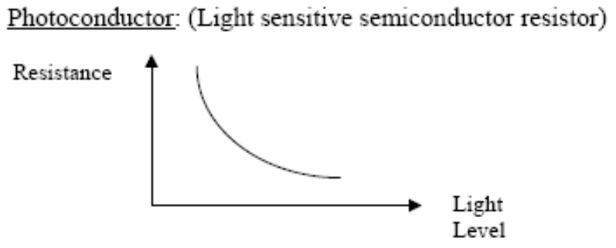
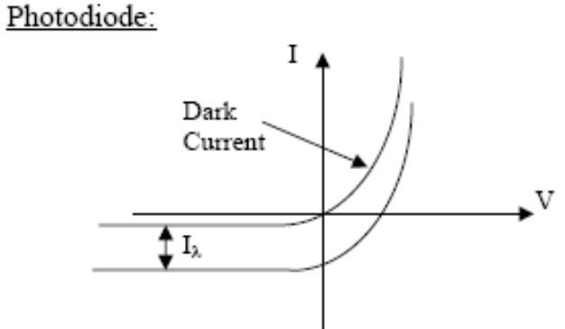

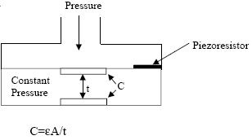
Example Primary Transducers
Light Sensor
  photoconductor
    light → ΔR
  photodiode
    light → ΔI
  membrane pressure sensor
    resistive (pressure → Δ R)
    capacitive (pressure → ΔC)

Slide 7
Displacement Measurements
Measurements of size, shape, and position utilize displacement sensors
Examples
  diameter of part under stress (direct)
  movement of a microphone diaphragm to quantify liquid movement through the heart (indirect)
Primary Transducer Types
  Resistive Sensors (Potentiometers & Strain Gages)
  Inductive Sensors
  Capacitive Sensors
  Piezoelectric Sensors
Secondary Transducers
  Wheatstone Bridge
  Amplifiers

Slide 8
Strain Gage: Gage Factor
Remember: for a strained thin wire
  ΔR/R = ΔL/L – ΔA/A + Δρ/ρ
    A = π (D/2)², for circular wire
Poisson’s ratio, μ: relates change in diameter D to change in length L
  ΔD/D = - μ ΔL/L
Thus
  ΔR/R = (1+2μ) ΔL/L + Δρ/ρ
Gage Factor, G, used to compare strain-gage materials
  G = ΔR/R = (1+2μ) + Δρ/ρ
  ΔL/L ΔL/L
D
L
dimensional effect
piezoresistive effect

Slide 9
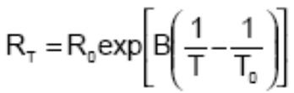
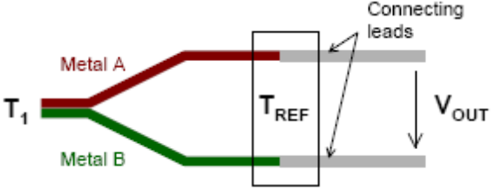
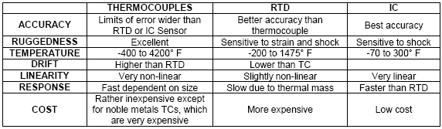
Temperature Sensor Options
Resistance Temperature Detectors (RTDs)
  Platinum, Nickel, Copper metals are typically used
  positive temperature coefficients
Thermistors (“thermally sensitive resistor”)
  formed from semiconductor materials, not metals
    often composite of a ceramic and a metallic oxide (Mn, Co, Cu or Fe)
  typically have negative temperature coefficients
Thermocouples
  based on the Seebeck effect: dissimilar metals at diff. temps. → signal

Slide 10
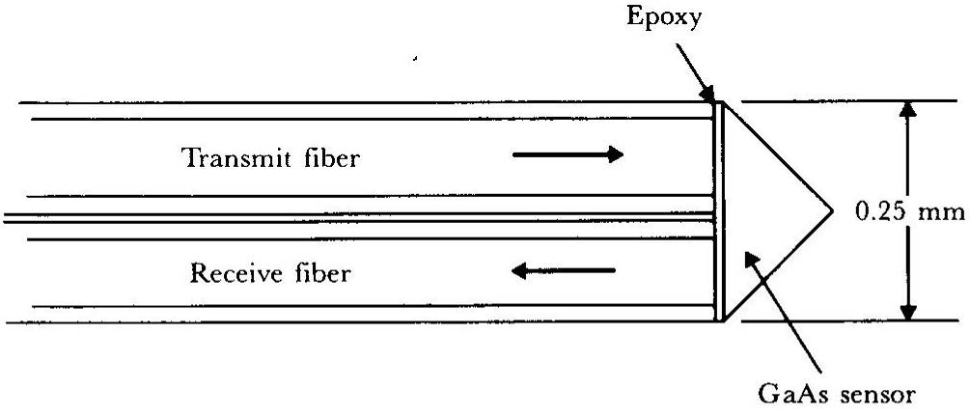
Fiber-optic Temperature Sensor
Sensor operation
  small prism-shaped sample of single-crystal undoped GaAs attached to ends of two optical fibers
  light energy absorbed by the GaAs crystal depends on temperature
  percentage of received vs. transmitted energy is a function of temperature
Can be made small enough for biological implantation
GaAs semiconductor temperature probe

Slide 11
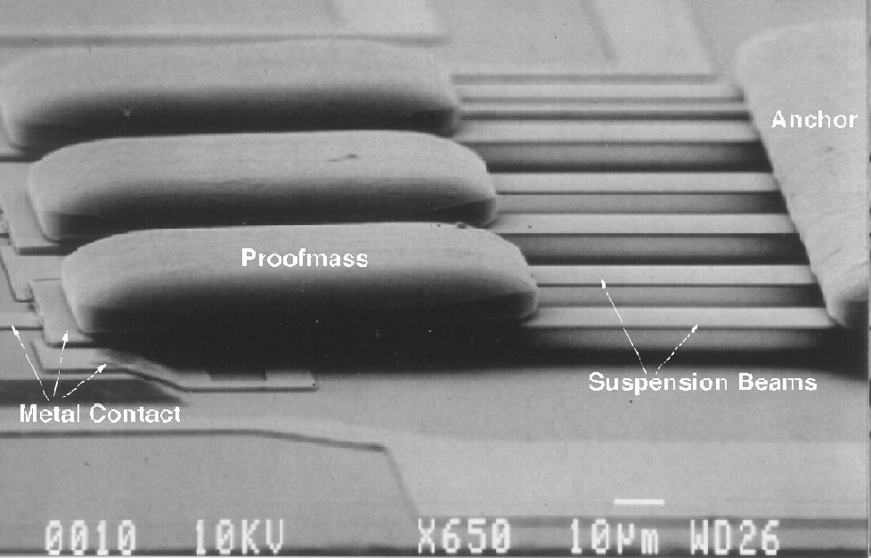
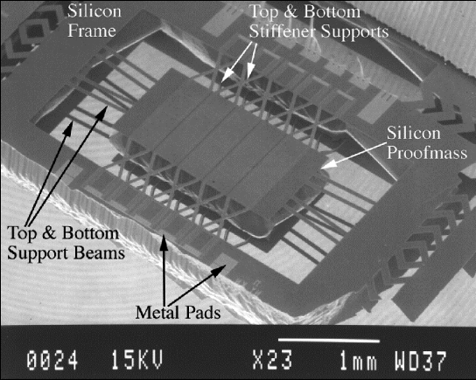
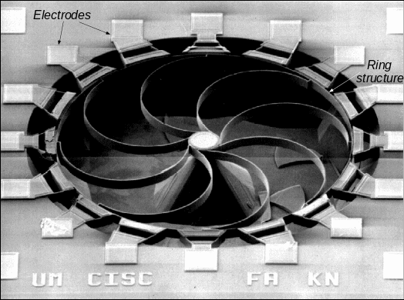
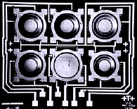
Example MEMS Transducers
MEMS = micro-electro-mechanical system
  miniature transducers created using IC fabrication processes
Microaccelerometer
  cantilever beam
  suspended mass
Rotation
  gyroscope
Pressure
Diaphragm (Upper electrode)
Lower electrode
5-10mm

Slide 12
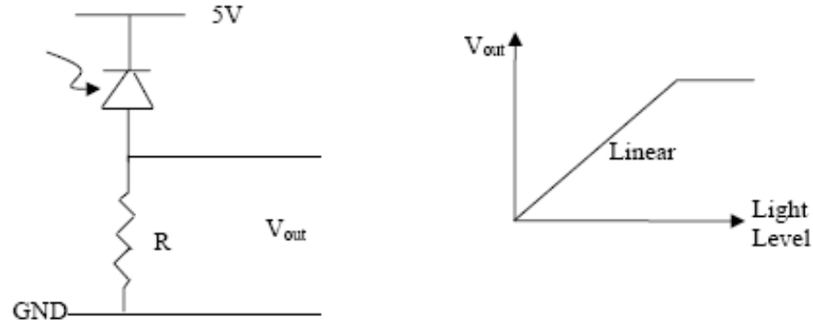
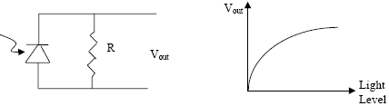
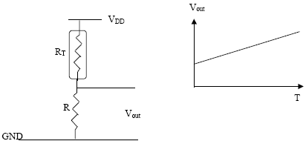
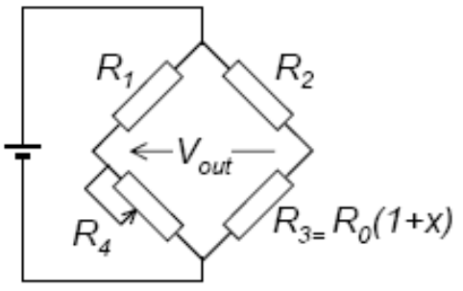
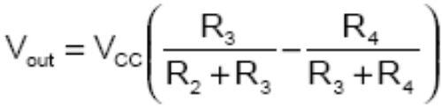
Passive Sensor Readout Circuit
Photodiode Circuits
Thermistor Half-Bridge
  voltage divider
  one element varies
Wheatstone Bridge
  R3 = resistive sensor
  R4 is matched to nominal value of R3
  If R₁ = R₂, V_{out-nominal} = 0
  V_{out} varies as R₃ changes
VCC
R1+R4

Slide 13
Operational Amplifiers
Properties
  open-loop gain: ideally infinite: practical values 20k-200k
    high open-loop gain → virtual short between + and - inputs
  input impedance: ideally infinite: CMOS opamps are close to ideal
  output impedance: ideally zero: practical values 20-100Ω
  zero output offset: ideally zero: practical value <1mV
  gain-bandwidth product (GB): practical values ~MHz
    frequency where open-loop gain drops to 1 V/V
Commercial opamps provide many different properties
  low noise
  low input current
  low power
  high bandwidth
  low/high supply voltage
  special purpose: comparator, instrumentation amplifier

Slide 14
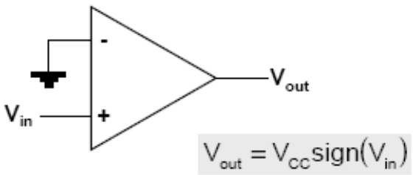
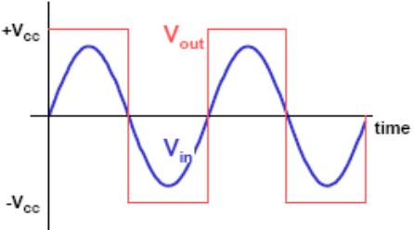
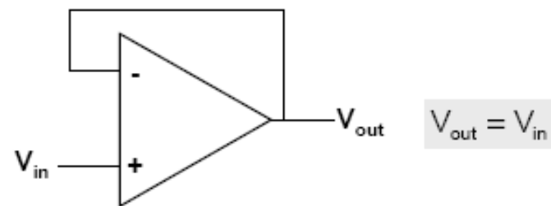
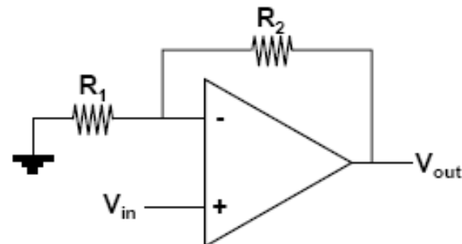
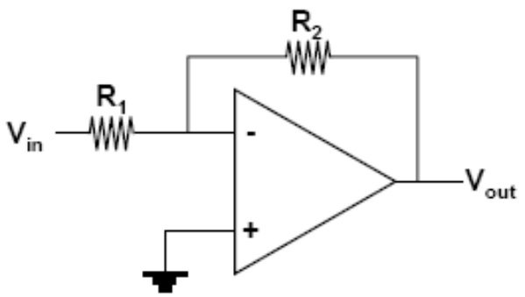
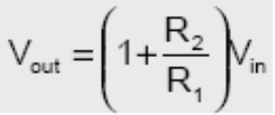
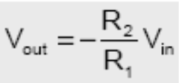
Basic Opamp Configuration
Voltage Comparator
  digitize input
Voltage Follower
  buffer
Non-Inverting Amp
Inverting Amp

Slide 15
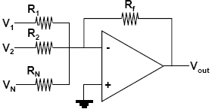
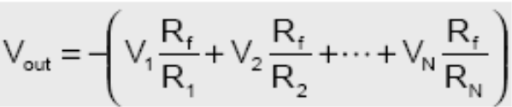
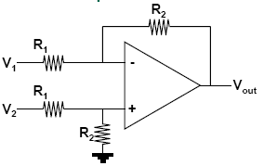
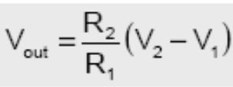
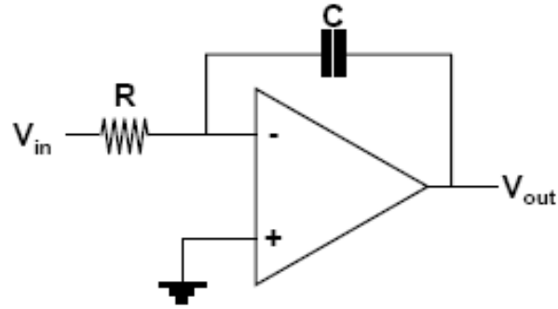
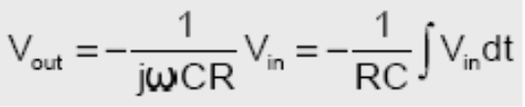
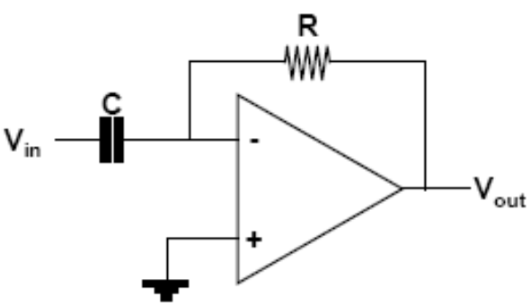
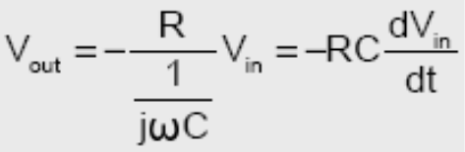
More Opamp Configurations
Summing Amp
Differential Amp
Integrating Amp
Differentiating Amp

Slide 16
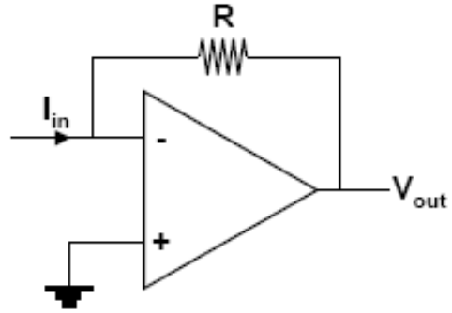

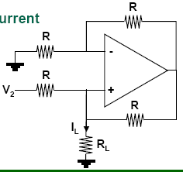
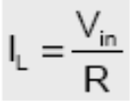
Converting Configuration
Current-to-Voltage
Voltage-to-Current

Slide 17
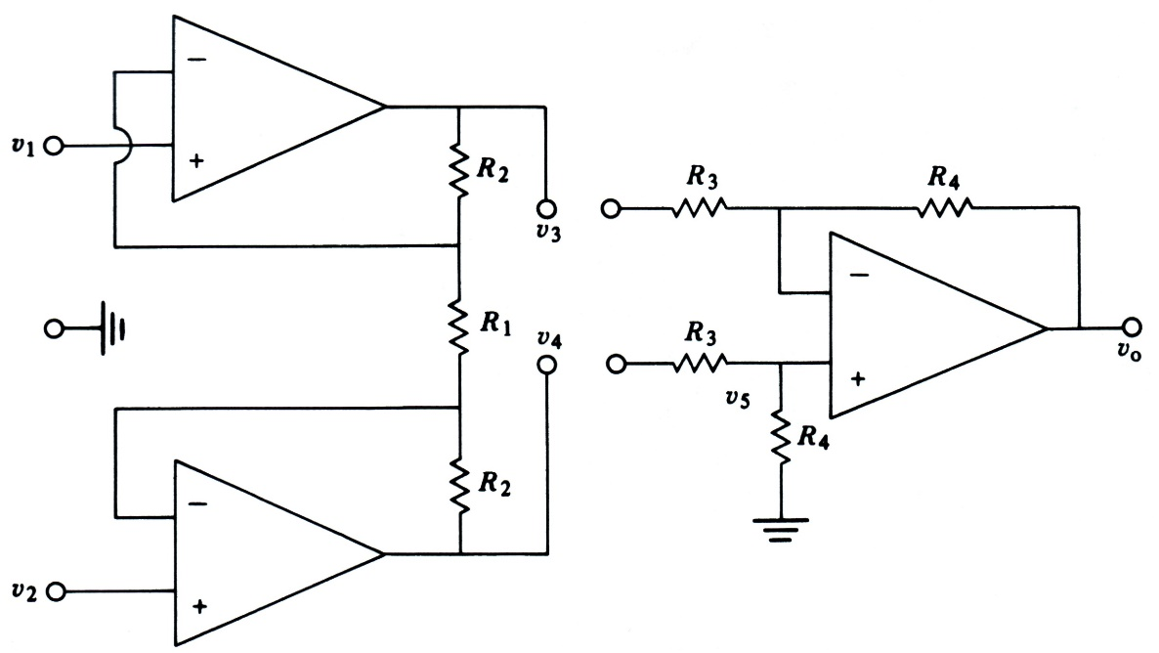
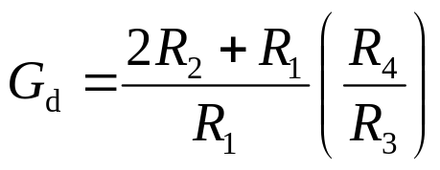
Instrumentation Amplifier
Robust differential
gain amplifier
Input stage
  high input impedance
    buffers gain stage
  no common mode gain
  can have differential gain
Gain stage
  differential gain, low input impedance
Overall amplifier
  amplifies only the differential component
    high common mode rejection ratio
  high input impedance suitable for biopotential electrodes with high output impedance
gain stage
input stage
total differential gain

Slide 18
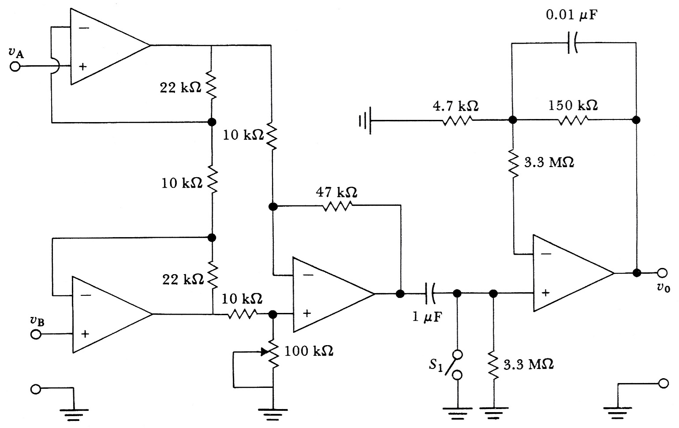
Instrumentation Amplifier w/ BP Filter
instrumentation amplifier
HPF
non-inverting amp
With 776 op amps, the circuit was found to have a CMRR of 86 dB at 100 Hz and a noise level of 40 mV peak to peak at the output. The frequency response was 0.04 to 150 Hz for ±3 dB and was flat over 4 to 40 Hz. The total gain is 25 (instrument amp) x 32 (non-inverting amp) = 800.

Slide 19
Connecting Sensors to Microcontrollers
Analog
  many microcontrollers have a built-in A/D
    8-bit to 12-bit common
    many have multi-channel A/D inputs
Digital
  serial I/O
    use serial I/O port, store in memory to analyze
    synchronous (with clock)
      must match byte format, stop/start bits, parity check, etc.
    asynchronous (no clock): more common for comm. than data
      must match baud rate and bit width, transmission protocol, etc.
  frequency encoded
    use timing port, measure pulse width or pulse frequency
sensor
µC
signal timing
memory
keypad
sensor
display
instrument

Slide 20
Connecting Smart Sensors to PC/Network
“Smart sensor” = sensor with built-in signal processing & communication
  e.g., combining a “dumb sensor” and a microcontroller
Data Acquisition Cards (DAQ)
  PC card with analog and digital I/O
  interface through LabVIEW or user-generated code
Communication Links Common for Sensors
  asynchronous serial comm.
    universal asynchronous receive and transmit (UART)
      1 receive line + 1 transmit line. nodes must match baud rate & protocol
    RS232 Serial Port on PCs uses UART format (but at +/- 12V)
      can buy a chip to convert from UART to RS232
  synchronous serial comm.
    serial peripheral interface (SPI)
      1 clock + 1 bidirectional data + 1 chip select/enable
  I²C = Inter Integrated Circuit bus
    designed by Philips for comm. inside TVs, used in several commercial sensor systems
  IEEE P1451: Sensor Comm. Standard
    several different sensor comm. protocols for different applications

Slide 21
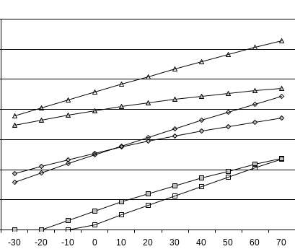
Sensor Calibration
Sensors can exhibit non-ideal effects
  offset: nominal output ≠ nominal parameter value
  nonlinearity: output not linear with parameter changes
  cross parameter sensitivity: secondary output variation with, e.g., temperature
Calibration = adjusting output to match parameter
  analog signal conditioning
  look-up table
  digital calibration
    T = a + bV +cV²,
      T= temperature; V=sensor voltage;
      a,b,c = calibration coefficients
Compensation
  remove secondary sensitivities
  must have sensitivities characterized
  can remove with polynomial evaluation
    P = a + bV + cT + dVT + e V², where P=pressure, T=temperature
linear
T1
non-linear
T2
offset
T3

